Slide 1

Action Planning
Using Search for Decisions

Slide 2
Planning in Games
Pathfinding is not the only application for search in games. It can also be used to find plans that solve AI problems on the fly. By searching through the actions available to an agent, we hope to find a sequence of actions – a plan – that will achieve our agent’s goal. We must find a plan before taking any action.
In Planning:
An agent has a number of possible actions
All actions have effects
Some actions may have preconditions
If any action fails, we must re-plan

Slide 3
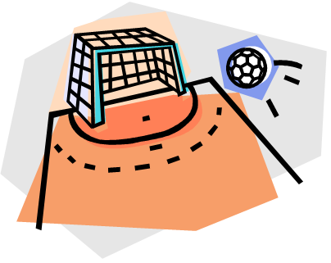
Goal-Oriented Action Planning
Goal-Oriented Action Planning (GOAP) starts with a goal state and then plans a sequence of actions to reach it. Good heuristics for GOAP are hard to find, so the state space is usually searched in reverse, starting from the goal. This continues until we reach actions that are valid in our current state.
Features of Goal-Oriented Action Planning:
Goal is some set of conditions of agent’s universe
Works backward from goal state, using actions
Actions have costs (or priorities)
Goals are sorted by priority or relevance

Slide 4







GOAP Example
Effects /
Actions
Preconditions
Actions
Goals
2
3
1
5
Actions are chained backwards from the goal until a set of currently valid actions is found. Costs (or priorities) are also considered in the calculation.

Slide 5
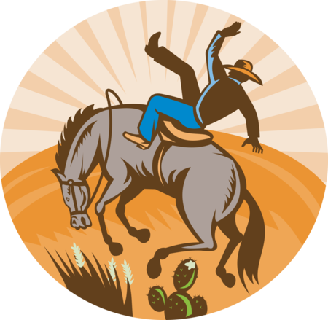
Goal-Oriented Action Planning
Benefits & Drawbacks
Benefits
Can produce surprising, complex, and adaptable behavior
Needs little coding for new agents – only abilities and goals
AI constraints are centralized and always followed
Drawbacks
Hard to control – understanding why AI picks plans
can be difficult without great debugging tools
Complex to implement
Concurrent actions are tricky (like running and shooting)
Slow – we are using A* to make decisions (graph search and sort)
For these reasons, GOAP is a niche technique for game AI currently.

